Slide 1
ArduiGo
By: YuFeng Yao & Mai Hong

Slide 2
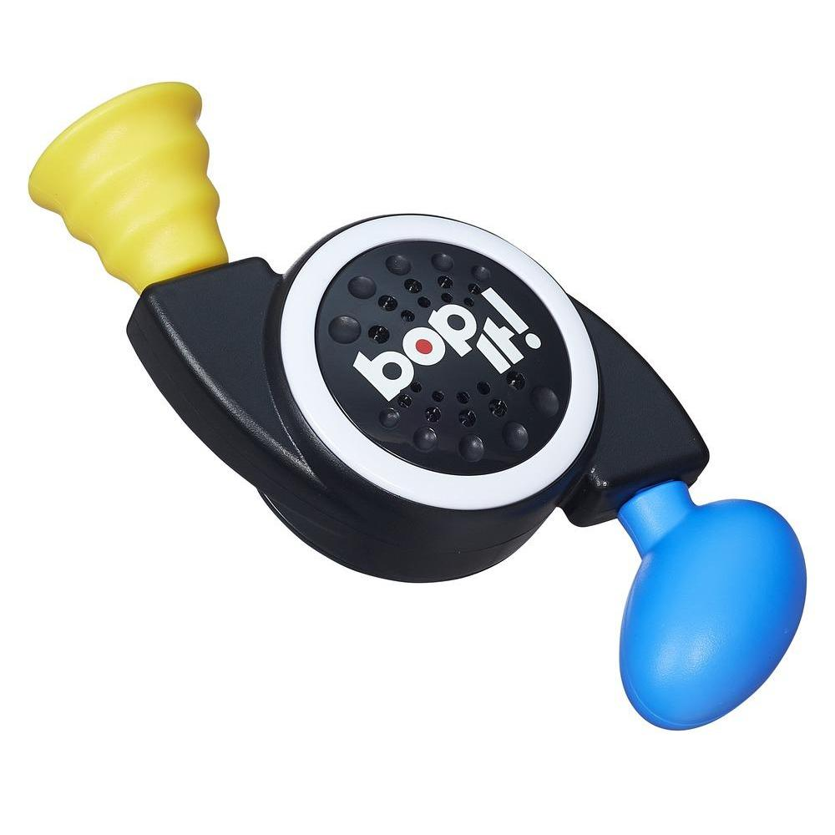
Project Description
Simple reaction time game inspired by Simon Says / bop it
Randomly generates command -> User performs the command
Time given decreases
Goal : see how many commands you can perform within the time span.

Slide 3
Sensors Used
5 commands with
Stretch = stretch
Flex = Bend
Distance = Poke
Button = Press red / green

Slide 4
Behind the Scenes
Challenges and Solutions

Slide 5
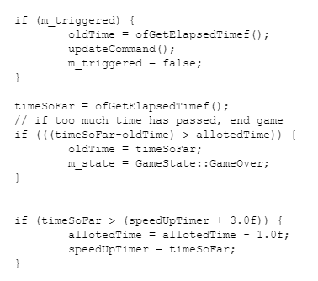
Problem
Solution
Give player less time per command as they play
Bool triggered resets timer if they complete the task
Old time = last time completed command
Allotted Time = amount of time to complete command. Start with 10
Every 3 seconds that passes, - 1 second

Slide 6
Problems
Solutions
Referencing variables across files
How to communicate the Arduino’s actions from ofApp.cpp to the Game.cpp file?
Incorporated pointers with help of online references

Slide 7
Problems
Solution
Non-Coding problems:
Hardware Limitations - Loose connectors -Dysfunctional components
Image scaling randomly in Google Drive
Stop the mental fixation that it’s a coding problem
Consider other aspects
Trial and error with different components to narrow down the issue
Comment out components with faulty hardware and continue working on other parts

Slide 8
Demonstration

Slide 9
Questions?

